Slide 1




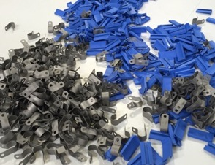
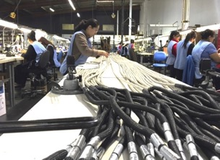
Management Presentation
PROPRIETARY INFORMATION OF J&M PRODUCTS, INC., SAN FERNANDO, CA

Slide 2
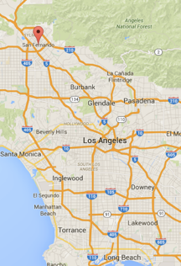
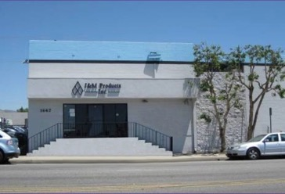
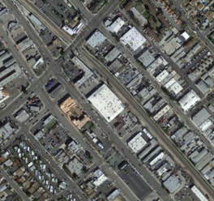

J&M Products, Inc. Overview
Established 1963, privately held since 1995
Located San Fernando, CA since 2003
42,000 Sq Ft
115 employees
THIS DOCUMENT CONTAINS PROPRIETARY INFORMATION, WHICH IS THE SOLE EXCLUSIVE PROPERTY OF J&M PRODUCTS, INC.. THE DOCUMENT IS ISSUED IN STRICT CONFIDENCE AND SHALL NOT BE DISCLOSED TO A THIRD PARTY OR USED FOR MANUFACTURE, PRODUCTION OR PROCUREMENT WITHOUT THE EXPRESS WRITTEN PERMISSION OF J&M PRODUCTS, INC.

Slide 3
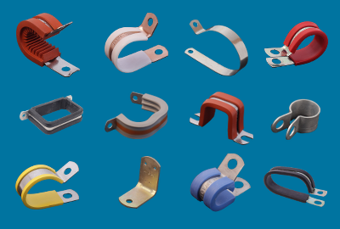
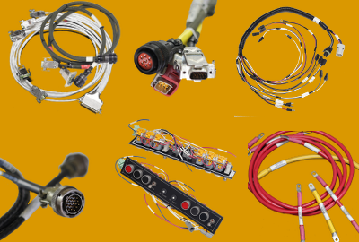
About J&M Products, Inc
Specializing in:
Line Support Clamps (Hydraulic, Fuel, Electrical, Pneumatic Applications)
Wire Harness Assemblies
Reputation for excellent service and flexibility to customer needs
North American operation with well established team
THIS DOCUMENT CONTAINS PROPRIETARY INFORMATION, WHICH IS THE SOLE EXCLUSIVE PROPERTY OF J&M PRODUCTS, INC.. THE DOCUMENT IS ISSUED IN STRICT CONFIDENCE AND SHALL NOT BE DISCLOSED TO A THIRD PARTY OR USED FOR MANUFACTURE, PRODUCTION OR PROCUREMENT WITHOUT THE EXPRESS WRITTEN PERMISSION OF J&M PRODUCTS, INC.

Slide 4

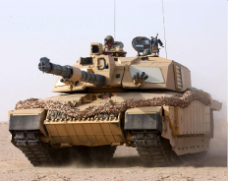
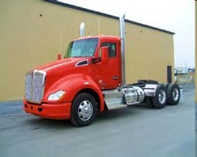
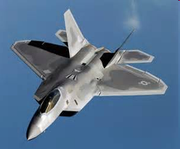
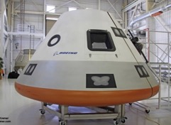
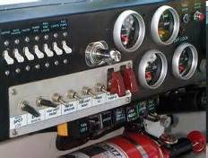
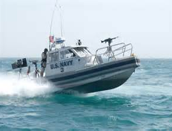
Markets
Commercial Aerospace
Defense
Industrial
Heavy Duty Trucking
Marine
Space
Test Equipment
Audio/Video
Instrumentation
Energy
THIS DOCUMENT CONTAINS PROPRIETARY INFORMATION, WHICH IS THE SOLE EXCLUSIVE PROPERTY OF J&M PRODUCTS, INC.. THE DOCUMENT IS ISSUED IN STRICT CONFIDENCE AND SHALL NOT BE DISCLOSED TO A THIRD PARTY OR USED FOR MANUFACTURE, PRODUCTION OR PROCUREMENT WITHOUT THE EXPRESS WRITTEN PERMISSION OF J&M PRODUCTS, INC.

Slide 5


























Major Customers
Clamps
Wire Harness
THIS DOCUMENT CONTAINS PROPRIETARY INFORMATION, WHICH IS THE SOLE EXCLUSIVE PROPERTY OF J&M PRODUCTS, INC.. THE DOCUMENT IS ISSUED IN STRICT CONFIDENCE AND SHALL NOT BE DISCLOSED TO A THIRD PARTY OR USED FOR MANUFACTURE, PRODUCTION OR PROCUREMENT WITHOUT THE EXPRESS WRITTEN PERMISSION OF J&M PRODUCTS, INC.
Notes:
5

Slide 6

Line Support Clamps & Brackets
THIS DOCUMENT CONTAINS PROPRIETARY INFORMATION, WHICH IS THE SOLE EXCLUSIVE PROPERTY OF J&M PRODUCTS, INC.. THE DOCUMENT IS ISSUED IN STRICT CONFIDENCE AND SHALL NOT BE DISCLOSED TO A THIRD PARTY OR USED FOR MANUFACTURE, PRODUCTION OR PROCUREMENT WITHOUT THE EXPRESS WRITTEN PERMISSION OF J&M PRODUCTS, INC.

Slide 7
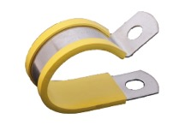
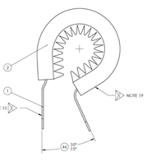
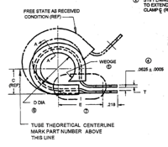
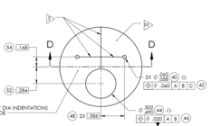
Line Support Clamps
Provide fast economical method of installing wire harnesses, hydraulic lines, etc.
Typical design consists of a metal band with rubber “cushion” material, that is then formed around a tube of specific diameter. Fastening holes are stamped into the metal band and the assembly is part marked along with the manufacturers identifier “JM” for J&M.
J&M industry leading supplier for applications:
Rugged/hostile environments
Helicopter / Military / Space / Marine installations
Commercial Aviation
Heavy Duty Trucking
Elastomer/Cushion options for heat, fuel, hydraulic fluid, and temperature variations from 1000F to -40F.
J&M proprietary tooling, molds, and compound qualification data with key elastomer partners
Full range of metals available
THIS DOCUMENT CONTAINS PROPRIETARY INFORMATION, WHICH IS THE SOLE EXCLUSIVE PROPERTY OF J&M PRODUCTS, INC.. THE DOCUMENT IS ISSUED IN STRICT CONFIDENCE AND SHALL NOT BE DISCLOSED TO A THIRD PARTY OR USED FOR MANUFACTURE, PRODUCTION OR PROCUREMENT WITHOUT THE EXPRESS WRITTEN PERMISSION OF J&M PRODUCTS, INC.
Notes:
7

Slide 8
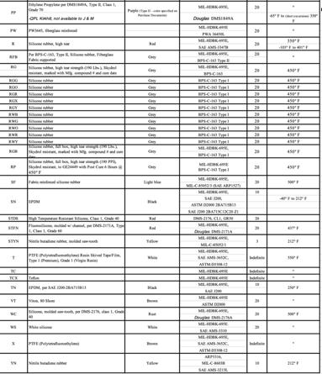
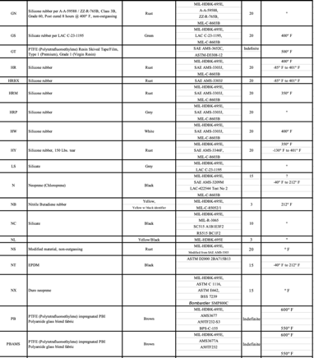
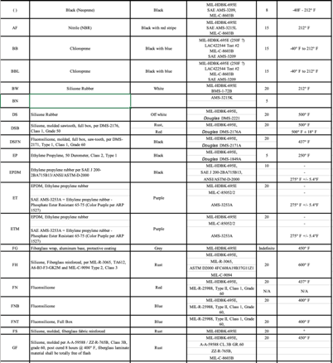
Cushion Materials
Large array of cushion materials, shapes and sizes on hand (204 part numbers)
Materials may be extruded or molded
Shelf life requirement applies
THIS DOCUMENT CONTAINS PROPRIETARY INFORMATION, WHICH IS THE SOLE EXCLUSIVE PROPERTY OF J&M PRODUCTS, INC.. THE DOCUMENT IS ISSUED IN STRICT CONFIDENCE AND SHALL NOT BE DISCLOSED TO A THIRD PARTY OR USED FOR MANUFACTURE, PRODUCTION OR PROCUREMENT WITHOUT THE EXPRESS WRITTEN PERMISSION OF J&M PRODUCTS, INC.
Notes:
8

Slide 9
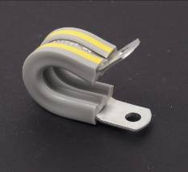
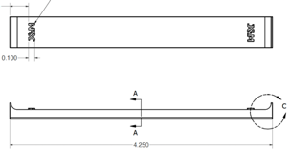
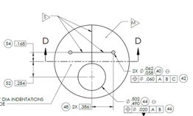
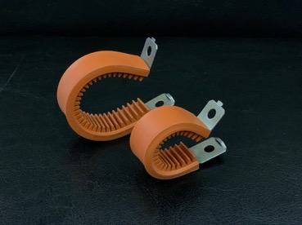

Cushion Materials
Molded and Extruded Cushion Examples
THIS DOCUMENT CONTAINS PROPRIETARY INFORMATION, WHICH IS THE SOLE EXCLUSIVE PROPERTY OF J&M PRODUCTS, INC.. THE DOCUMENT IS ISSUED IN STRICT CONFIDENCE AND SHALL NOT BE DISCLOSED TO A THIRD PARTY OR USED FOR MANUFACTURE, PRODUCTION OR PROCUREMENT WITHOUT THE EXPRESS WRITTEN PERMISSION OF J&M PRODUCTS, INC.
Notes:
9

Slide 10
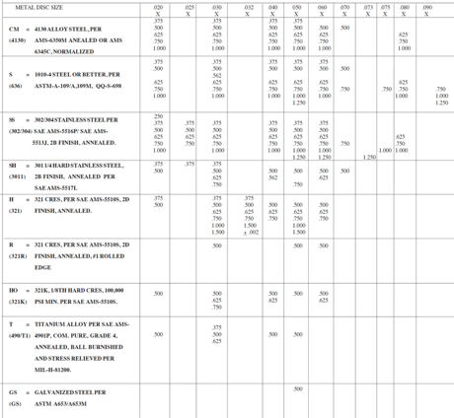
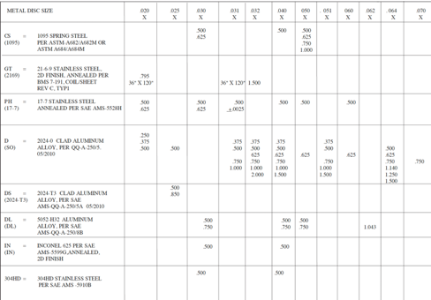
Metal Band Options
Wide selection of metal band sizes (width x thickness) and materials
85 part numbers on hand
Metal processing options (outside process) include cad plate, zinc nickel, ceramic deburr, anodize, heat treatment, passivation, yellow zinc, etc. per specifications.
THIS DOCUMENT CONTAINS PROPRIETARY INFORMATION, WHICH IS THE SOLE EXCLUSIVE PROPERTY OF J&M PRODUCTS, INC.. THE DOCUMENT IS ISSUED IN STRICT CONFIDENCE AND SHALL NOT BE DISCLOSED TO A THIRD PARTY OR USED FOR MANUFACTURE, PRODUCTION OR PROCUREMENT WITHOUT THE EXPRESS WRITTEN PERMISSION OF J&M PRODUCTS, INC.
Notes:
10

Slide 11
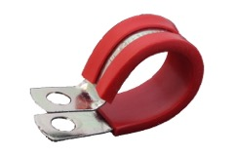
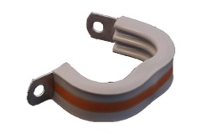
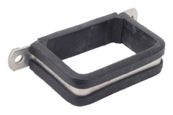
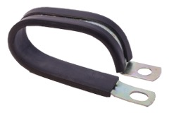

Line Support Clamps
J&M brand is one of only a few established in aerospace.
Competitors include Umpco, Pacmet, Adel (Transdigm) and TA (Transdigm).
J&M provides complete range of off-the-shelf sizes including, AS, MS, NAS, M85052, etc. A few gaps exist due to TA/Kirkhill grandfathered materials no longer sold to J&M.
J&M custom designs for unique installation requirements = J&M part number on OEM BOM
OEM designed parts manufactured by J&M = J&M sole-source or limited list of sources on OEM drawing
Design Recommendations, Prototypes, Production
THIS DOCUMENT CONTAINS PROPRIETARY INFORMATION, WHICH IS THE SOLE EXCLUSIVE PROPERTY OF J&M PRODUCTS, INC.. THE DOCUMENT IS ISSUED IN STRICT CONFIDENCE AND SHALL NOT BE DISCLOSED TO A THIRD PARTY OR USED FOR MANUFACTURE, PRODUCTION OR PROCUREMENT WITHOUT THE EXPRESS WRITTEN PERMISSION OF J&M PRODUCTS, INC.

Slide 12
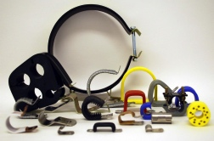
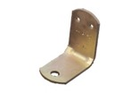
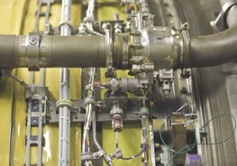
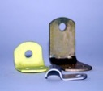
Special Clamping Assemblies
Custom Assemblies
Customized to application requirements
Brackets
Utilized for high vibration, additional strength, or compound angles
Brackets manufactured to specific design requirements
THIS DOCUMENT CONTAINS PROPRIETARY INFORMATION, WHICH IS THE SOLE EXCLUSIVE PROPERTY OF J&M PRODUCTS, INC.. THE DOCUMENT IS ISSUED IN STRICT CONFIDENCE AND SHALL NOT BE DISCLOSED TO A THIRD PARTY OR USED FOR MANUFACTURE, PRODUCTION OR PROCUREMENT WITHOUT THE EXPRESS WRITTEN PERMISSION OF J&M PRODUCTS, INC.

Slide 13
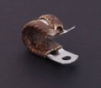

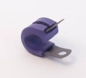
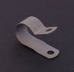
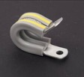
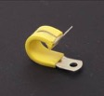
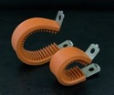
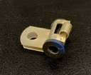
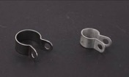
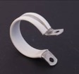
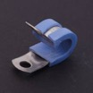
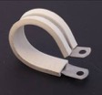










J&M Products, Inc - Clamp Product Line Example Sheet
1. Line Support Clamps / p-clips
a
b
c
d
e
f
g
h
i
j
k
l
2. Saddle Clamps
a
b
c
d
e
f
g
h
i
j
THIS DOCUMENT CONTAINS PROPRIETARY INFORMATION, WHICH IS THE SOLE EXCLUSIVE PROPERTY OF J&M PRODUCTS, INC.. THE DOCUMENT IS ISSUED IN STRICT CONFIDENCE AND SHALL NOT BE DISCLOSED TO A THIRD PARTY OR USED FOR MANUFACTURE, PRODUCTION OR PROCUREMENT WITHOUT THE EXPRESS WRITTEN PERMISSION OF J&M PRODUCTS, INC.

Slide 14




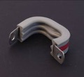
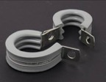
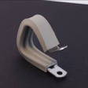
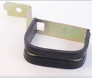

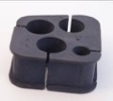










J&M Products, Inc - Clamp Product Line Example Sheet
3. Rectangular and Multi-Line Clamps
a
b
c
d
4. Hinged clamps and irregular shapes
a
b
c
d
5. Molded Blocks, Grommets, and Cushion
a
b
c
d
e
f
g
6. Custom shapes and Brackets
a
b
c
d
e
THIS DOCUMENT CONTAINS PROPRIETARY INFORMATION, WHICH IS THE SOLE EXCLUSIVE PROPERTY OF J&M PRODUCTS, INC.. THE DOCUMENT IS ISSUED IN STRICT CONFIDENCE AND SHALL NOT BE DISCLOSED TO A THIRD PARTY OR USED FOR MANUFACTURE, PRODUCTION OR PROCUREMENT WITHOUT THE EXPRESS WRITTEN PERMISSION OF J&M PRODUCTS, INC.

Slide 15




Approx 150 base part numbers
All sizes, typically up to size 50 or 64 (1/16th inch per size)
Most cushion options
Silicone, Flurosilicone, Nitrile, EPDM, Fiberglass (wrapped with aluminum dip), Teflon (etched/natural)
Including all options, approx 48,000 part numbers total
Several new base part numbers in work with OEMs currently
THIS DOCUMENT CONTAINS PROPRIETARY INFORMATION, WHICH IS THE SOLE EXCLUSIVE PROPERTY OF J&M PRODUCTS, INC.. THE DOCUMENT IS ISSUED IN STRICT CONFIDENCE AND SHALL NOT BE DISCLOSED TO A THIRD PARTY OR USED FOR MANUFACTURE, PRODUCTION OR PROCUREMENT WITHOUT THE EXPRESS WRITTEN PERMISSION OF J&M PRODUCTS, INC.

Slide 16
Clamp Supply Chain
Established supply chain, most based in southern California
Metal
Several suppliers with long term relationships with J&M
Demand varies on types of metals, suppliers are familiar with J&M ordering patterns and expectations
Cushion Extruded
Key suppliers for certain run-rates and/or material specifications
Some suppliers approved sources for OEM materials
Cushion Molded
Two suppliers with long relationship to J&M
Tooling retained at suppliers
Qualified sources for some OEM specified materials
Minimal quality issues
Minimal delivery issues (except for world event driven situations)
THIS DOCUMENT CONTAINS PROPRIETARY INFORMATION, WHICH IS THE SOLE EXCLUSIVE PROPERTY OF J&M PRODUCTS, INC.. THE DOCUMENT IS ISSUED IN STRICT CONFIDENCE AND SHALL NOT BE DISCLOSED TO A THIRD PARTY OR USED FOR MANUFACTURE, PRODUCTION OR PROCUREMENT WITHOUT THE EXPRESS WRITTEN PERMISSION OF J&M PRODUCTS, INC.
Notes:
16

Slide 17


J&M Proprietary Drawings and Tooling
THIS DOCUMENT CONTAINS PROPRIETARY INFORMATION, WHICH IS THE SOLE EXCLUSIVE PROPERTY OF J&M PRODUCTS, INC.. THE DOCUMENT IS ISSUED IN STRICT CONFIDENCE AND SHALL NOT BE DISCLOSED TO A THIRD PARTY OR USED FOR MANUFACTURE, PRODUCTION OR PROCUREMENT WITHOUT THE EXPRESS WRITTEN PERMISSION OF J&M PRODUCTS, INC.
Notes:
17

Slide 18


J&M Proprietary Drawings and Tooling
THIS DOCUMENT CONTAINS PROPRIETARY INFORMATION, WHICH IS THE SOLE EXCLUSIVE PROPERTY OF J&M PRODUCTS, INC.. THE DOCUMENT IS ISSUED IN STRICT CONFIDENCE AND SHALL NOT BE DISCLOSED TO A THIRD PARTY OR USED FOR MANUFACTURE, PRODUCTION OR PROCUREMENT WITHOUT THE EXPRESS WRITTEN PERMISSION OF J&M PRODUCTS, INC.
Notes:
18

Slide 19





J&M Proprietary Drawings and Tooling
THIS DOCUMENT CONTAINS PROPRIETARY INFORMATION, WHICH IS THE SOLE EXCLUSIVE PROPERTY OF J&M PRODUCTS, INC.. THE DOCUMENT IS ISSUED IN STRICT CONFIDENCE AND SHALL NOT BE DISCLOSED TO A THIRD PARTY OR USED FOR MANUFACTURE, PRODUCTION OR PROCUREMENT WITHOUT THE EXPRESS WRITTEN PERMISSION OF J&M PRODUCTS, INC.
Notes:
19

Slide 20


Production Management Custom Tools
Paccar Buffer
Boeing MinMax
THIS DOCUMENT CONTAINS PROPRIETARY INFORMATION, WHICH IS THE SOLE EXCLUSIVE PROPERTY OF J&M PRODUCTS, INC.. THE DOCUMENT IS ISSUED IN STRICT CONFIDENCE AND SHALL NOT BE DISCLOSED TO A THIRD PARTY OR USED FOR MANUFACTURE, PRODUCTION OR PROCUREMENT WITHOUT THE EXPRESS WRITTEN PERMISSION OF J&M PRODUCTS, INC.
Notes:
20

Slide 21
Wire Harnesses
THIS DOCUMENT CONTAINS PROPRIETARY INFORMATION, WHICH IS THE SOLE EXCLUSIVE PROPERTY OF J&M PRODUCTS, INC.. THE DOCUMENT IS ISSUED IN STRICT CONFIDENCE AND SHALL NOT BE DISCLOSED TO A THIRD PARTY OR USED FOR MANUFACTURE, PRODUCTION OR PROCUREMENT WITHOUT THE EXPRESS WRITTEN PERMISSION OF J&M PRODUCTS, INC.

Slide 22






Wire Harnesses
Build to print wire harnesses/assemblies per customer requirements, for use in aircraft cabin interiors, flight simulation, test labs, class 8 trucks, etc.
J&M industry leading supplier for applications:
Rugged/hostile environments
Heavy Duty Trucking (PACCAR Preferred Supplier)
Aircraft cabin interiors
Helicopter/Military installations
Typical manufacturing process incorporates procurement of raw materials (wire, connectors, shielding, etc) through major distribution partners. Wire bundle is then custom made per customer requirements along with EMI shielding, jacketing and labeling.
All parts are then 100% inspected and tested.
J&M regularly works with customer engineering to develop new designs and check for manufacturability. Prototype concepts are developed together at J&M to minimize errors.
J&M wire harness assembly team capabilities also extend to electronic box builds, including electro-mechanical actuation systems.
THIS DOCUMENT CONTAINS PROPRIETARY INFORMATION, WHICH IS THE SOLE EXCLUSIVE PROPERTY OF J&M PRODUCTS, INC.. THE DOCUMENT IS ISSUED IN STRICT CONFIDENCE AND SHALL NOT BE DISCLOSED TO A THIRD PARTY OR USED FOR MANUFACTURE, PRODUCTION OR PROCUREMENT WITHOUT THE EXPRESS WRITTEN PERMISSION OF J&M PRODUCTS, INC.
Notes:
22

Slide 23





Production Capabilities
Manufacture to IPC/WHMA-A-620
Ultrasonic Splicing
Injection Molding
Braiding
Electro-Mechanical Assembly
Solder Connections
Discrete Terminations
Automated Crimping (all sizes)
Custom Part Marking
Established Quality Processes
Final Test (Continuity, Hi-Pot, Insulation Resistance, Dielectric)
Final Inspection and Certification
Lot Traceability
THIS DOCUMENT CONTAINS PROPRIETARY INFORMATION, WHICH IS THE SOLE EXCLUSIVE PROPERTY OF J&M PRODUCTS, INC.. THE DOCUMENT IS ISSUED IN STRICT CONFIDENCE AND SHALL NOT BE DISCLOSED TO A THIRD PARTY OR USED FOR MANUFACTURE, PRODUCTION OR PROCUREMENT WITHOUT THE EXPRESS WRITTEN PERMISSION OF J&M PRODUCTS, INC.

Slide 24



Product Experience
Custom Cable Assemblies
Molded Assemblies
Audio/Video Assemblies
Discrete Wire Assemblies
Multi Conductor Assemblies
Power & Battery Cable Assemblies
Instrumentation Cable & Harnessing
Shielded Harnesses
Actuation
THIS DOCUMENT CONTAINS PROPRIETARY INFORMATION, WHICH IS THE SOLE EXCLUSIVE PROPERTY OF J&M PRODUCTS, INC.. THE DOCUMENT IS ISSUED IN STRICT CONFIDENCE AND SHALL NOT BE DISCLOSED TO A THIRD PARTY OR USED FOR MANUFACTURE, PRODUCTION OR PROCUREMENT WITHOUT THE EXPRESS WRITTEN PERMISSION OF J&M PRODUCTS, INC.

Slide 25





Project Capabilities
Solar energy actuation system project
Electrical Box Build
Kitting for mechanical structure (to ship to job site)
Electro-Mechanical Actuator assembly and test
3PL management
Factory certification CSA
THIS DOCUMENT CONTAINS PROPRIETARY INFORMATION, WHICH IS THE SOLE EXCLUSIVE PROPERTY OF J&M PRODUCTS, INC.. THE DOCUMENT IS ISSUED IN STRICT CONFIDENCE AND SHALL NOT BE DISCLOSED TO A THIRD PARTY OR USED FOR MANUFACTURE, PRODUCTION OR PROCUREMENT WITHOUT THE EXPRESS WRITTEN PERMISSION OF J&M PRODUCTS, INC.
Notes:
25

Slide 26
Wire Harness Supply Chain
Established supply chain, most based in southern California
Key partnerships with major distributors
Stocking programs for connectors (long leadtime, high $)
Discounted pricing
Forecasting of stock levels per J&M customer forecasts
J&M buy ahead on part numbers that are popular/high runners to support regular customer demands
Crane
Paccar
Collins
Minimal quality issues
Minimal delivery issues (except for world event driven situations)
THIS DOCUMENT CONTAINS PROPRIETARY INFORMATION, WHICH IS THE SOLE EXCLUSIVE PROPERTY OF J&M PRODUCTS, INC.. THE DOCUMENT IS ISSUED IN STRICT CONFIDENCE AND SHALL NOT BE DISCLOSED TO A THIRD PARTY OR USED FOR MANUFACTURE, PRODUCTION OR PROCUREMENT WITHOUT THE EXPRESS WRITTEN PERMISSION OF J&M PRODUCTS, INC.
Notes:
26

Slide 27

Organization
THIS DOCUMENT CONTAINS PROPRIETARY INFORMATION, WHICH IS THE SOLE EXCLUSIVE PROPERTY OF J&M PRODUCTS, INC.. THE DOCUMENT IS ISSUED IN STRICT CONFIDENCE AND SHALL NOT BE DISCLOSED TO A THIRD PARTY OR USED FOR MANUFACTURE, PRODUCTION OR PROCUREMENT WITHOUT THE EXPRESS WRITTEN PERMISSION OF J&M PRODUCTS, INC.
Notes:
27

Slide 28

Certifications & Approvals
AS9100 Rev D
ISO 9001:2015
SAE Committee
CAGE Code 22175
Boeing BQMS
Lockheed Star Supplier
PACCAR Certified, 10PPM Award
Rolls-Royce Certified
THIS DOCUMENT CONTAINS PROPRIETARY INFORMATION, WHICH IS THE SOLE EXCLUSIVE PROPERTY OF J&M PRODUCTS, INC.. THE DOCUMENT IS ISSUED IN STRICT CONFIDENCE AND SHALL NOT BE DISCLOSED TO A THIRD PARTY OR USED FOR MANUFACTURE, PRODUCTION OR PROCUREMENT WITHOUT THE EXPRESS WRITTEN PERMISSION OF J&M PRODUCTS, INC.

Slide 29







Comprehensive Manufacturing System
ERP System
EDI Capable
Scheduling & Logistics Programs
Kanban
Min/Max
Extensive Raw Material Inventory
Capacity Planning
Bar Coding
Lean Manufacturing
THIS DOCUMENT CONTAINS PROPRIETARY INFORMATION, WHICH IS THE SOLE EXCLUSIVE PROPERTY OF J&M PRODUCTS, INC.. THE DOCUMENT IS ISSUED IN STRICT CONFIDENCE AND SHALL NOT BE DISCLOSED TO A THIRD PARTY OR USED FOR MANUFACTURE, PRODUCTION OR PROCUREMENT WITHOUT THE EXPRESS WRITTEN PERMISSION OF J&M PRODUCTS, INC.

Slide 30

Organization
AG
2 + 1 FT open
3
1
4
AG+CR
1 + outsourced
CR
AG +
1 outsourced
2 + 1 outsourced
Outsourced PEO +
1 FT open
HIRED
QA System – Outsourced
I.T – Outsourced
HR – Outsourced w/PEO
Finance – Outsourced w/CPA
Recruiting 2x FT positions
THIS DOCUMENT CONTAINS PROPRIETARY INFORMATION, WHICH IS THE SOLE EXCLUSIVE PROPERTY OF J&M PRODUCTS, INC.. THE DOCUMENT IS ISSUED IN STRICT CONFIDENCE AND SHALL NOT BE DISCLOSED TO A THIRD PARTY OR USED FOR MANUFACTURE, PRODUCTION OR PROCUREMENT WITHOUT THE EXPRESS WRITTEN PERMISSION OF J&M PRODUCTS, INC.
Notes:
30

Slide 31

Organization
1
16
CR
15
34
AG
Flexible workforce cross-trained
FT core team, highly experienced
Scale using Temp workforce
THIS DOCUMENT CONTAINS PROPRIETARY INFORMATION, WHICH IS THE SOLE EXCLUSIVE PROPERTY OF J&M PRODUCTS, INC.. THE DOCUMENT IS ISSUED IN STRICT CONFIDENCE AND SHALL NOT BE DISCLOSED TO A THIRD PARTY OR USED FOR MANUFACTURE, PRODUCTION OR PROCUREMENT WITHOUT THE EXPRESS WRITTEN PERMISSION OF J&M PRODUCTS, INC.
Notes:
31

Slide 32

Customers
THIS DOCUMENT CONTAINS PROPRIETARY INFORMATION, WHICH IS THE SOLE EXCLUSIVE PROPERTY OF J&M PRODUCTS, INC.. THE DOCUMENT IS ISSUED IN STRICT CONFIDENCE AND SHALL NOT BE DISCLOSED TO A THIRD PARTY OR USED FOR MANUFACTURE, PRODUCTION OR PROCUREMENT WITHOUT THE EXPRESS WRITTEN PERMISSION OF J&M PRODUCTS, INC.
Notes:
32

Slide 33


Market Position
Competitors
Transdigm (TA & Adel)
Pacmet
Umpco
Barriers to entry
J&M has proprietary tooling, part numbers, materials
J&M is listed on drawings, sometimes sole supplier, sometimes alongside TA or Adel
Regulatory drivers
SAE committees
NADCAP (PRI) influence
Customer relationships
Longevity
Depth of relationships
Willingness to create LTAs, find a deal that works for both parties
Note: COVID-19 start date of December 12th, 2019
THIS DOCUMENT CONTAINS PROPRIETARY INFORMATION, WHICH IS THE SOLE EXCLUSIVE PROPERTY OF J&M PRODUCTS, INC.. THE DOCUMENT IS ISSUED IN STRICT CONFIDENCE AND SHALL NOT BE DISCLOSED TO A THIRD PARTY OR USED FOR MANUFACTURE, PRODUCTION OR PROCUREMENT WITHOUT THE EXPRESS WRITTEN PERMISSION OF J&M PRODUCTS, INC.
Notes:
33

Slide 34

Customer Concentration
THIS DOCUMENT CONTAINS PROPRIETARY INFORMATION, WHICH IS THE SOLE EXCLUSIVE PROPERTY OF J&M PRODUCTS, INC.. THE DOCUMENT IS ISSUED IN STRICT CONFIDENCE AND SHALL NOT BE DISCLOSED TO A THIRD PARTY OR USED FOR MANUFACTURE, PRODUCTION OR PROCUREMENT WITHOUT THE EXPRESS WRITTEN PERMISSION OF J&M PRODUCTS, INC.
Notes:
34

Slide 35




Customer Concentration
Over 500 customers
Largest concentration (sales $) Boeing Distribution Services (KLX)
No seasonality
2018
$10.8 MM
2019
$10.4 MM
2020
$8.3 MM
2021
$7.6 MM
THIS DOCUMENT CONTAINS PROPRIETARY INFORMATION, WHICH IS THE SOLE EXCLUSIVE PROPERTY OF J&M PRODUCTS, INC.. THE DOCUMENT IS ISSUED IN STRICT CONFIDENCE AND SHALL NOT BE DISCLOSED TO A THIRD PARTY OR USED FOR MANUFACTURE, PRODUCTION OR PROCUREMENT WITHOUT THE EXPRESS WRITTEN PERMISSION OF J&M PRODUCTS, INC.
Notes:
35

Slide 36


Booking and Sales Consistency
discussion
Bookings
800-
600-
400-
2009
2022
Feb 2017
Mar 2020
Sales
800-
600-
400-
Note: COVID-19 start date of December 12th, 2019
THIS DOCUMENT CONTAINS PROPRIETARY INFORMATION, WHICH IS THE SOLE EXCLUSIVE PROPERTY OF J&M PRODUCTS, INC.. THE DOCUMENT IS ISSUED IN STRICT CONFIDENCE AND SHALL NOT BE DISCLOSED TO A THIRD PARTY OR USED FOR MANUFACTURE, PRODUCTION OR PROCUREMENT WITHOUT THE EXPRESS WRITTEN PERMISSION OF J&M PRODUCTS, INC.
Notes:
36

Slide 37


Sales Ratios (2019 baseline)
Quantity Ratios
Clamps : Wire Harness = 99:1
Aerospace : Auto/Industrial = 47:53
$ Ratios
Clamps : Wire Harness = 70:30
Aerospace : Auto/Industrial = 76:24
Note: 2019 example utilized, since COVID-19 start date was December 12th, 2019
THIS DOCUMENT CONTAINS PROPRIETARY INFORMATION, WHICH IS THE SOLE EXCLUSIVE PROPERTY OF J&M PRODUCTS, INC.. THE DOCUMENT IS ISSUED IN STRICT CONFIDENCE AND SHALL NOT BE DISCLOSED TO A THIRD PARTY OR USED FOR MANUFACTURE, PRODUCTION OR PROCUREMENT WITHOUT THE EXPRESS WRITTEN PERMISSION OF J&M PRODUCTS, INC.
Notes:
37

Slide 38

Market Position
Part Number Exclusivity
J&M has approximately 20,000 part numbers in the ERP system, this includes Clamp, Wire Harnesses, all sizes and material combinations. Note that some drawings may have additional options not programmed into our database due to a lack of demand.
The approximate breakdown of “Sole Source” and “Only Source” is shown in the table below.
Definition:
“Sole Source” = where J&M is the incumbent supplier of a part number, and there is no apparent effort or intent by the customer to re-source the supply of these part numbers.
“Only Source” = where J&M is the only source of this part number, including J&M part numbers (J&M drawings).
THIS DOCUMENT CONTAINS PROPRIETARY INFORMATION, WHICH IS THE SOLE EXCLUSIVE PROPERTY OF J&M PRODUCTS, INC.. THE DOCUMENT IS ISSUED IN STRICT CONFIDENCE AND SHALL NOT BE DISCLOSED TO A THIRD PARTY OR USED FOR MANUFACTURE, PRODUCTION OR PROCUREMENT WITHOUT THE EXPRESS WRITTEN PERMISSION OF J&M PRODUCTS, INC.

Slide 39

Strategic Growth
THIS DOCUMENT CONTAINS PROPRIETARY INFORMATION, WHICH IS THE SOLE EXCLUSIVE PROPERTY OF J&M PRODUCTS, INC.. THE DOCUMENT IS ISSUED IN STRICT CONFIDENCE AND SHALL NOT BE DISCLOSED TO A THIRD PARTY OR USED FOR MANUFACTURE, PRODUCTION OR PROCUREMENT WITHOUT THE EXPRESS WRITTEN PERMISSION OF J&M PRODUCTS, INC.
Notes:
39

Slide 40

Strategic Growth
Molded cushion implementation (already in action)
Umpco market capture
December 2021 start of implementation
2022 improve process and tooling for speed
Engine & Landing Gear Focus
Opportunity exists for PMA alternate parts
Market growth though OEM selection
Airframe diversity (Airbus)
Engines (replace incumbent clamp supplier)
Aerospace forecast (both clamp and wire harness customers) indicate
2023 for solid growth/recovery
2024 OEM at full production rates
Note: 2022Q1 booking = $4.28MM
CAPEX opportunities
PMA projects
Capacity growth
Margin growth (automation)
THIS DOCUMENT CONTAINS PROPRIETARY INFORMATION, WHICH IS THE SOLE EXCLUSIVE PROPERTY OF J&M PRODUCTS, INC.. THE DOCUMENT IS ISSUED IN STRICT CONFIDENCE AND SHALL NOT BE DISCLOSED TO A THIRD PARTY OR USED FOR MANUFACTURE, PRODUCTION OR PROCUREMENT WITHOUT THE EXPRESS WRITTEN PERMISSION OF J&M PRODUCTS, INC.
Notes:
40

Slide 41


Thank You
THIS DOCUMENT CONTAINS PROPRIETARY INFORMATION, WHICH IS THE SOLE EXCLUSIVE PROPERTY OF J&M PRODUCTS, INC.. THE DOCUMENT IS ISSUED IN STRICT CONFIDENCE AND SHALL NOT BE DISCLOSED TO A THIRD PARTY OR USED FOR MANUFACTURE, PRODUCTION OR PROCUREMENT WITHOUT THE EXPRESS WRITTEN PERMISSION OF J&M PRODUCTS, INC.
Notes:
41

