Slide 1
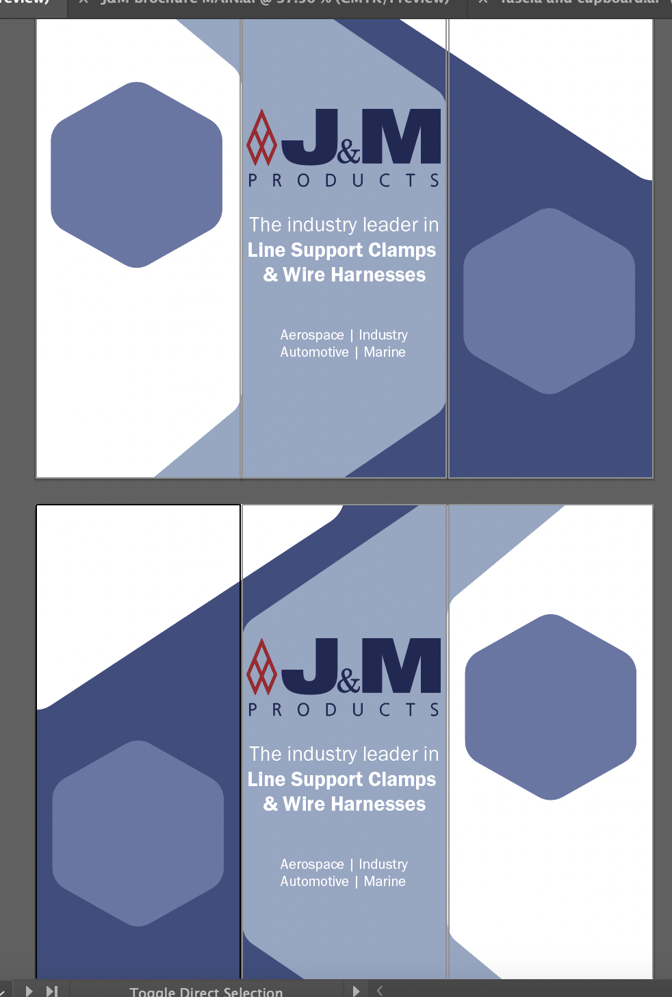
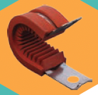
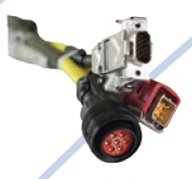
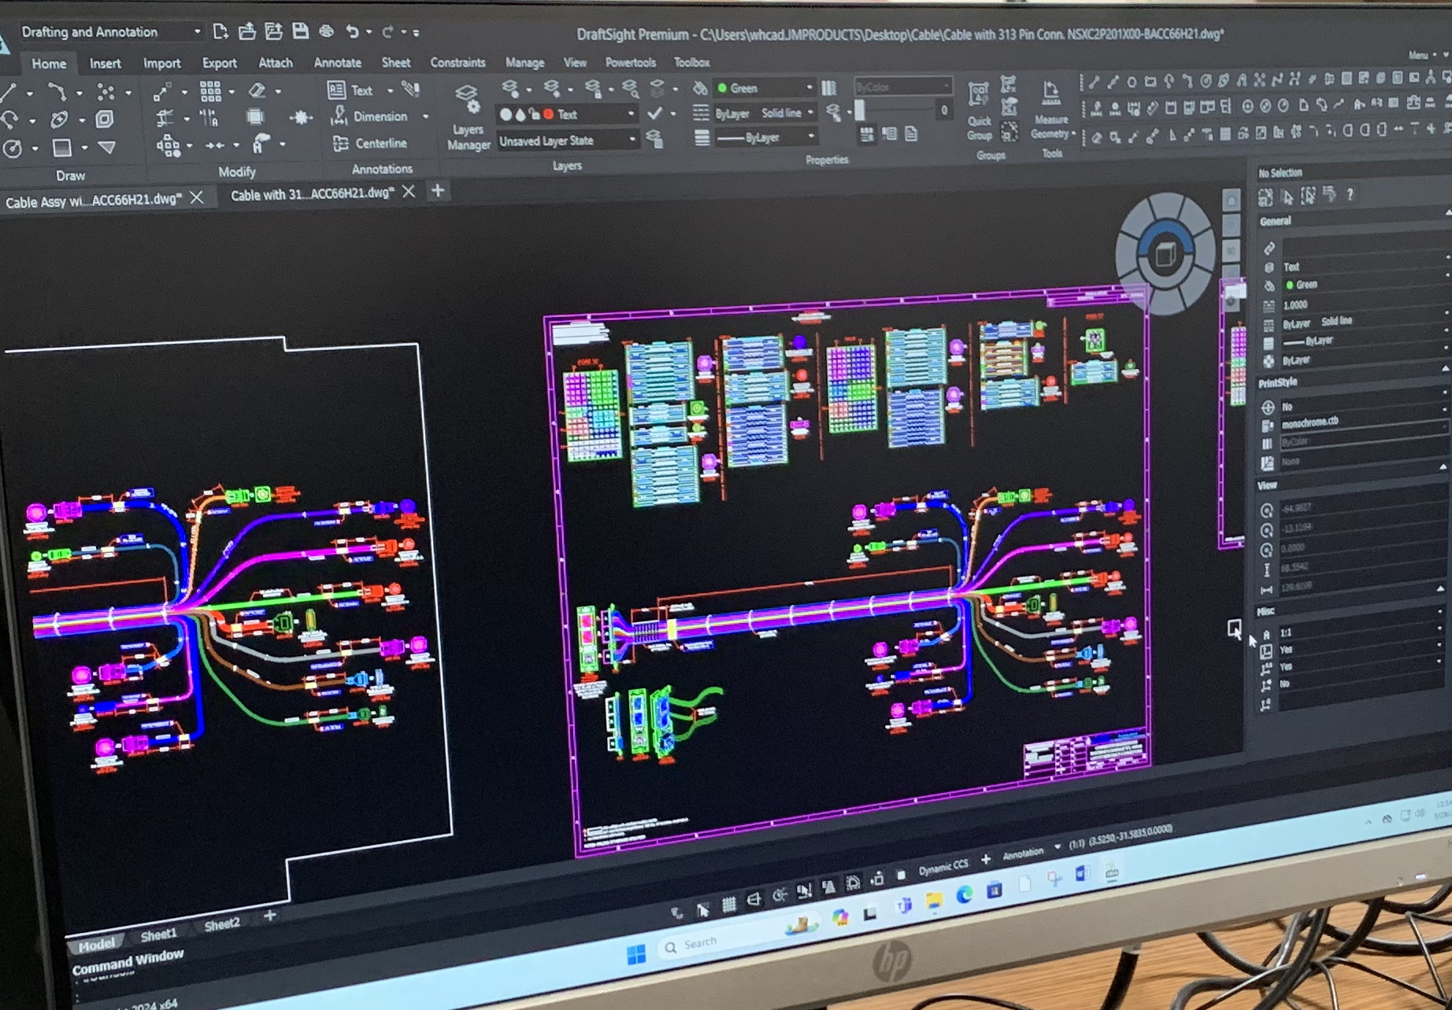
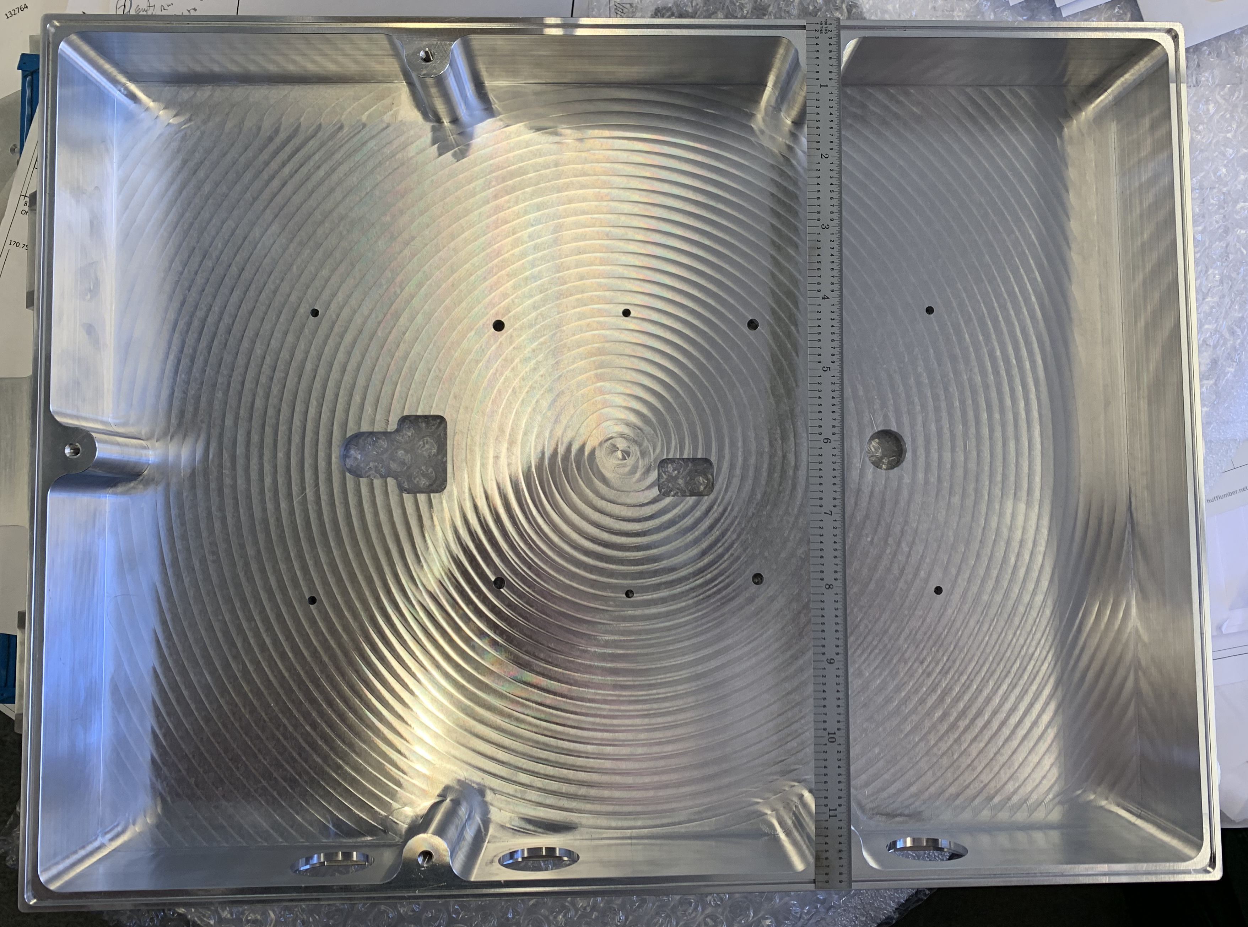
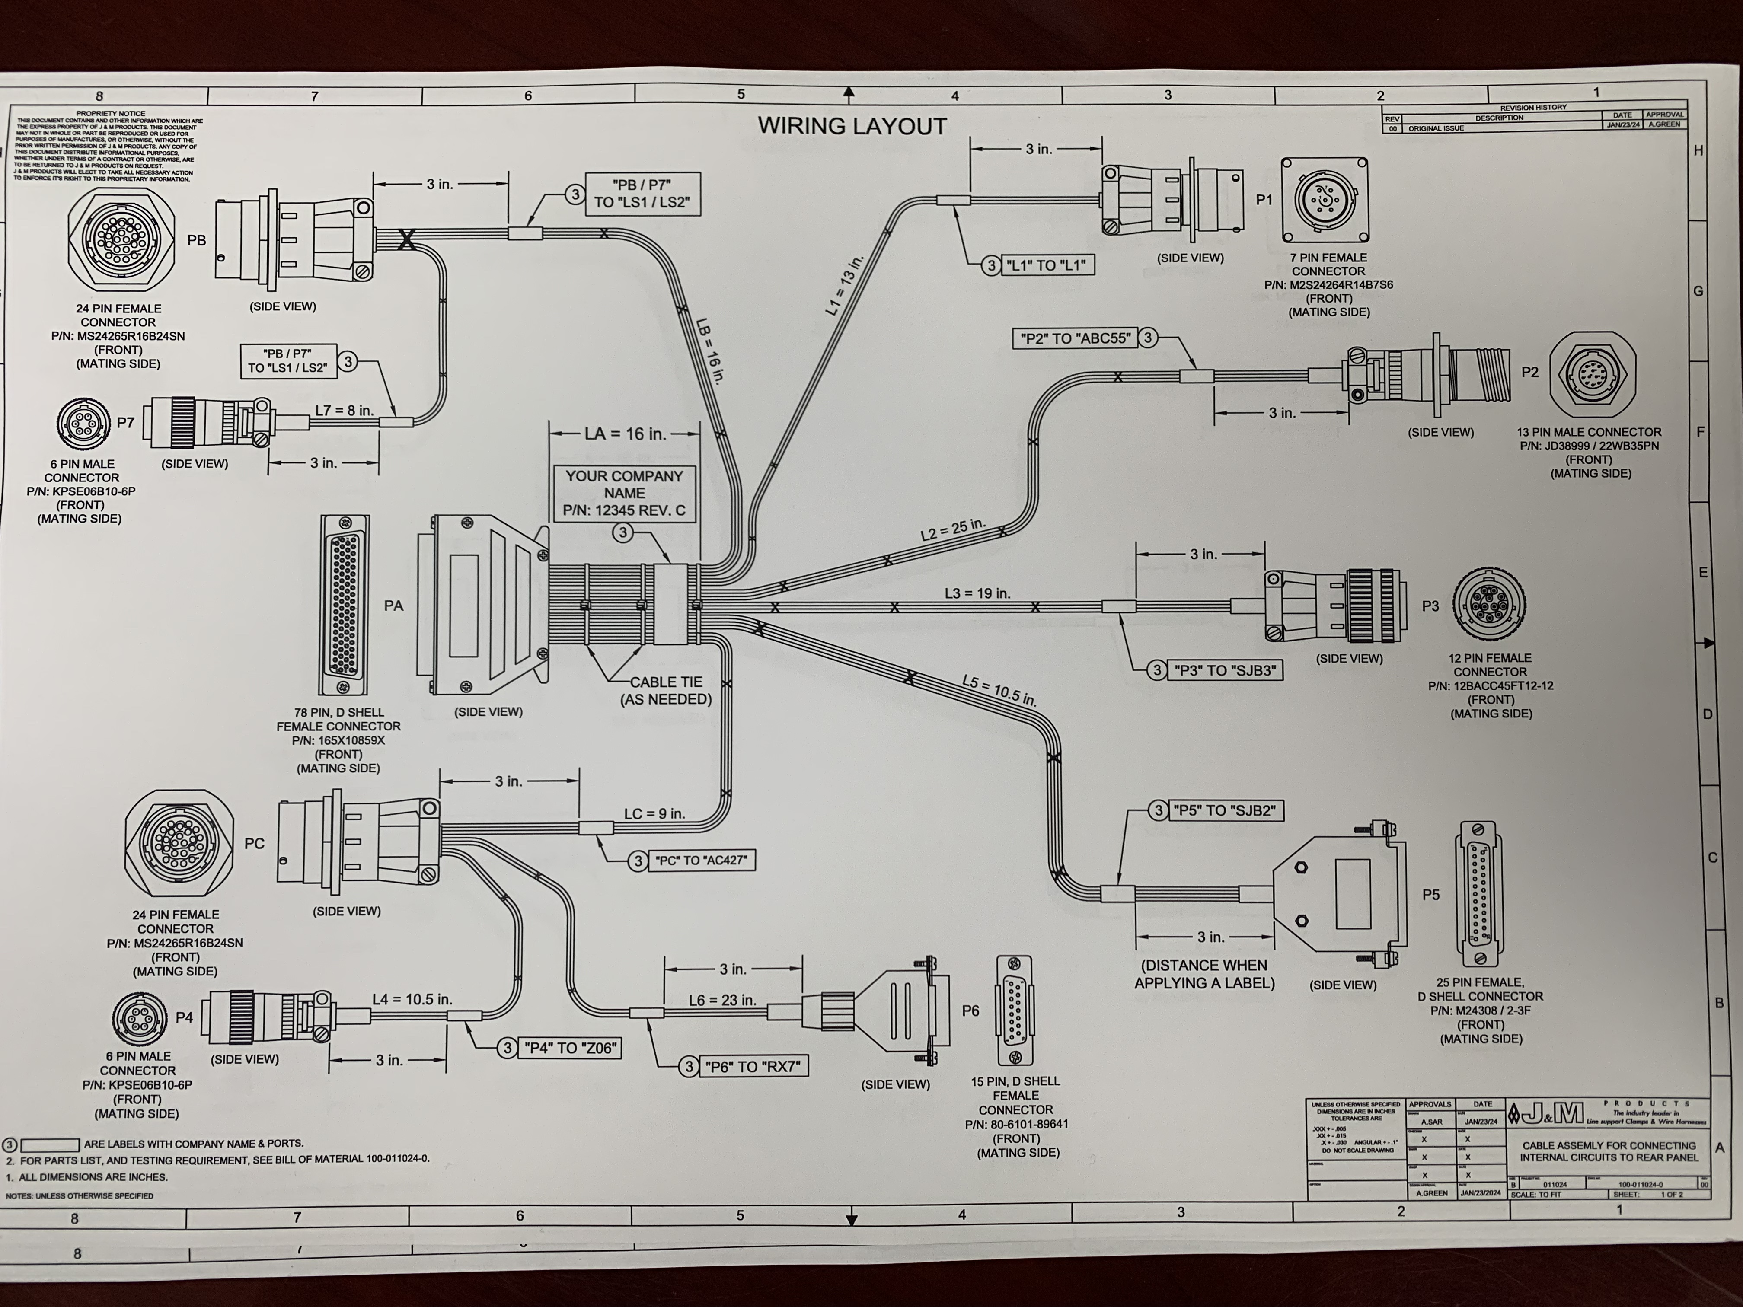
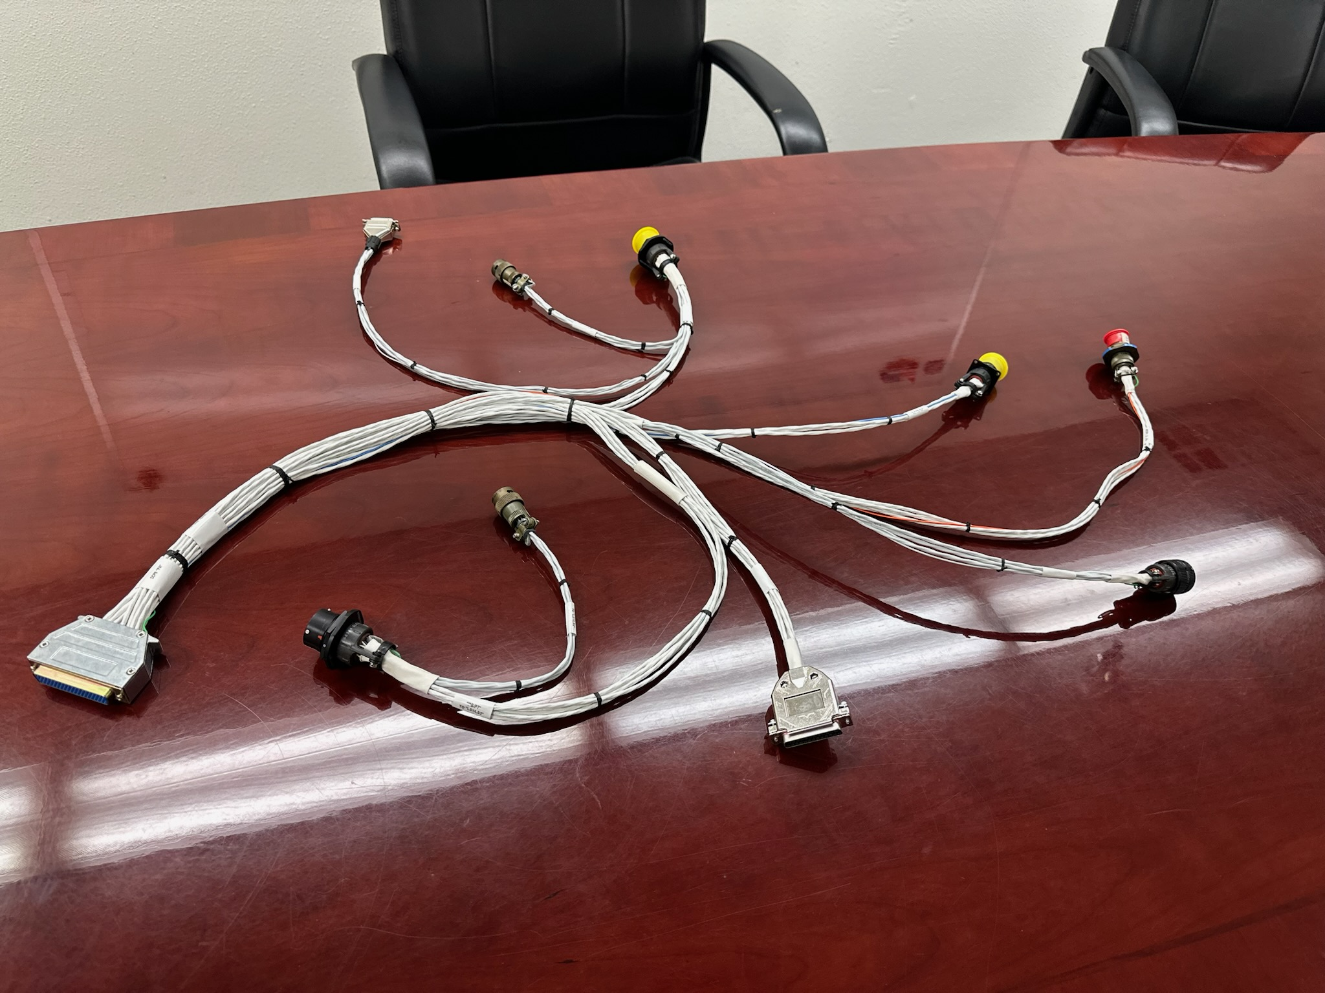
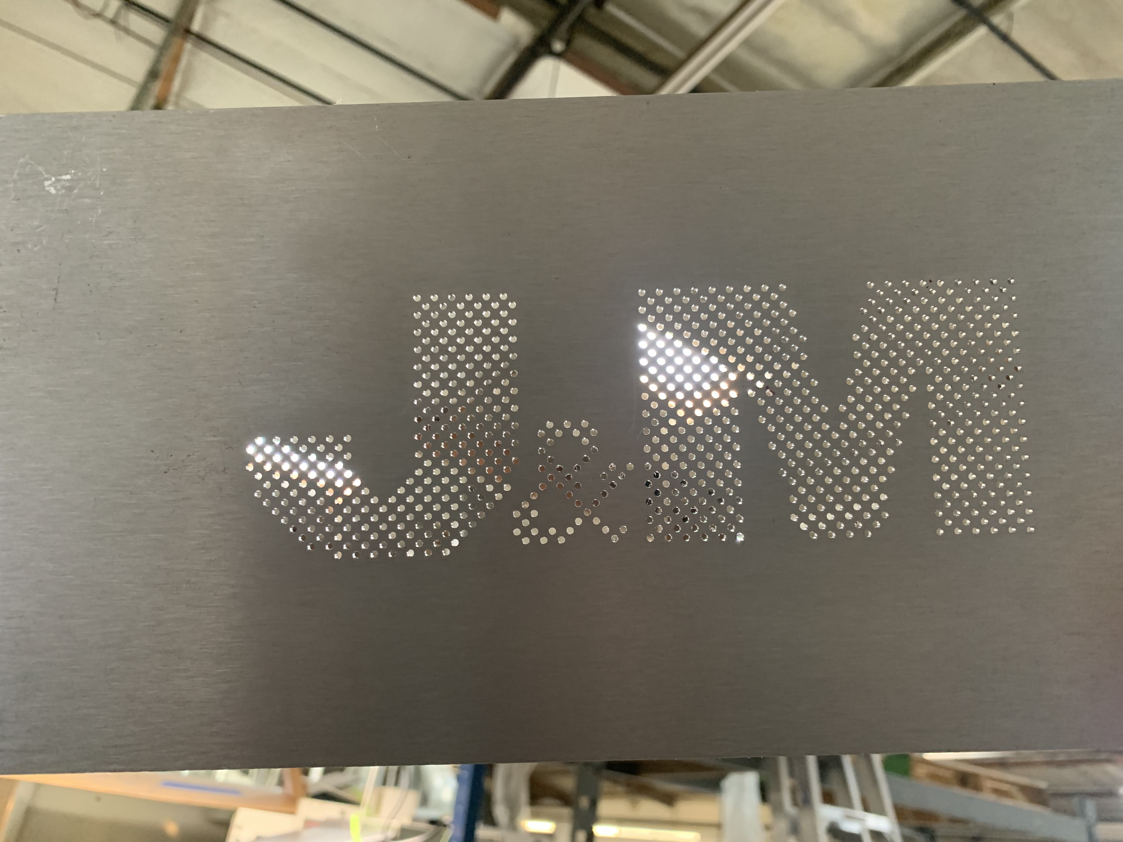
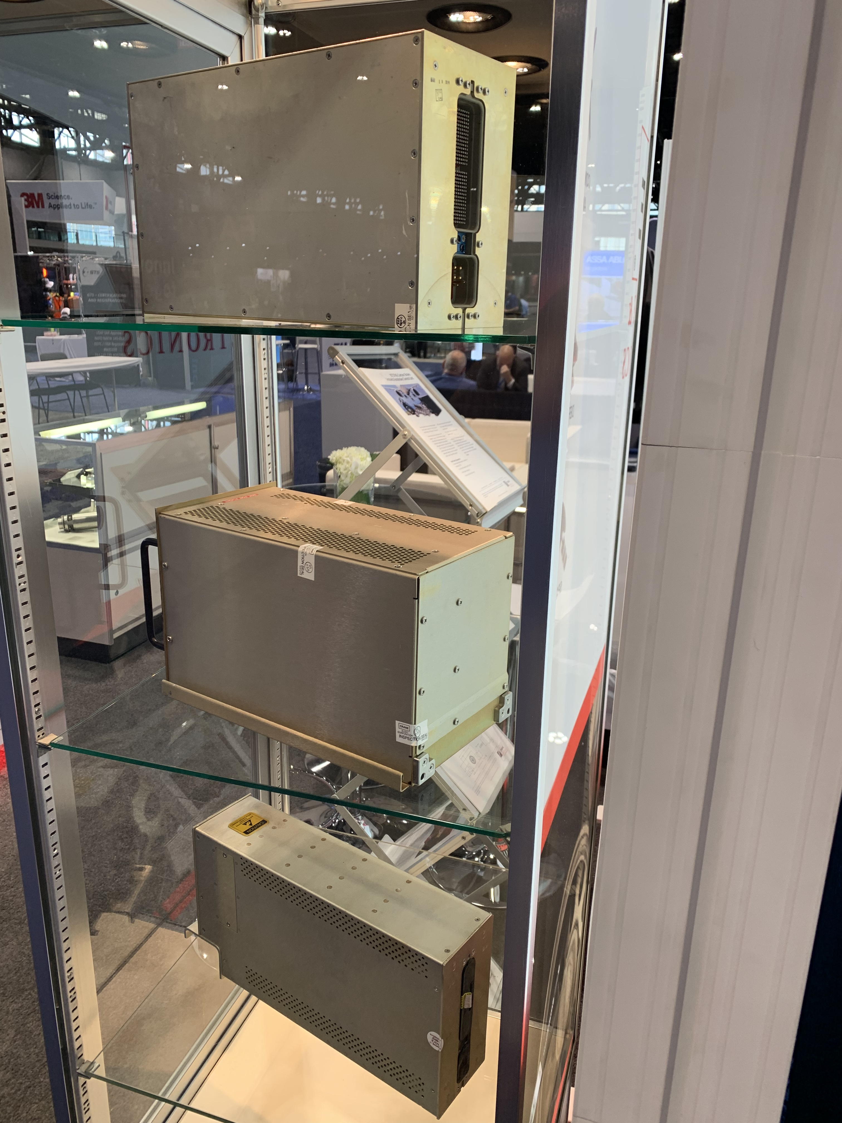
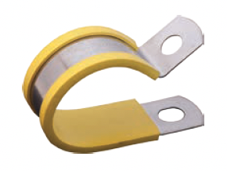
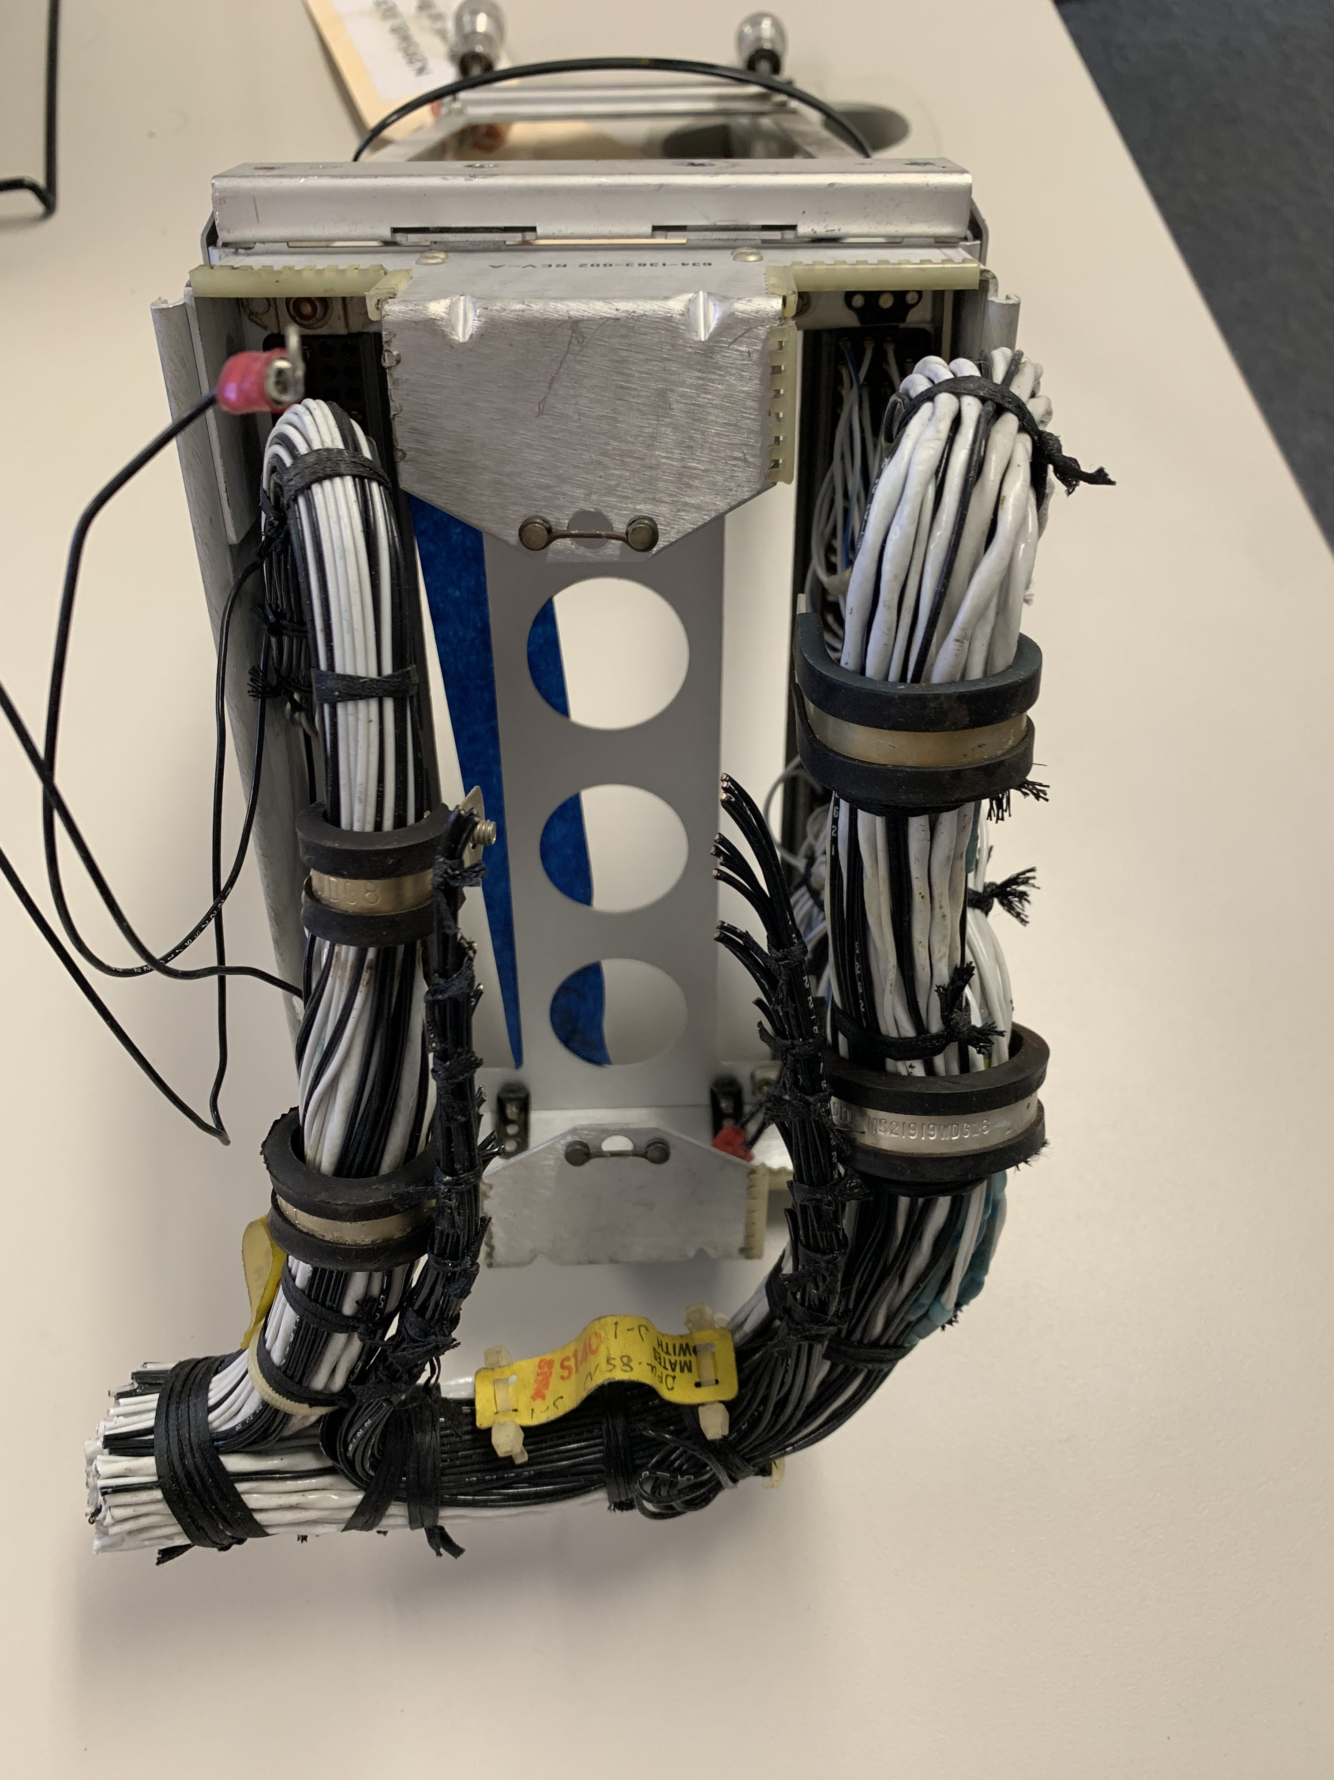
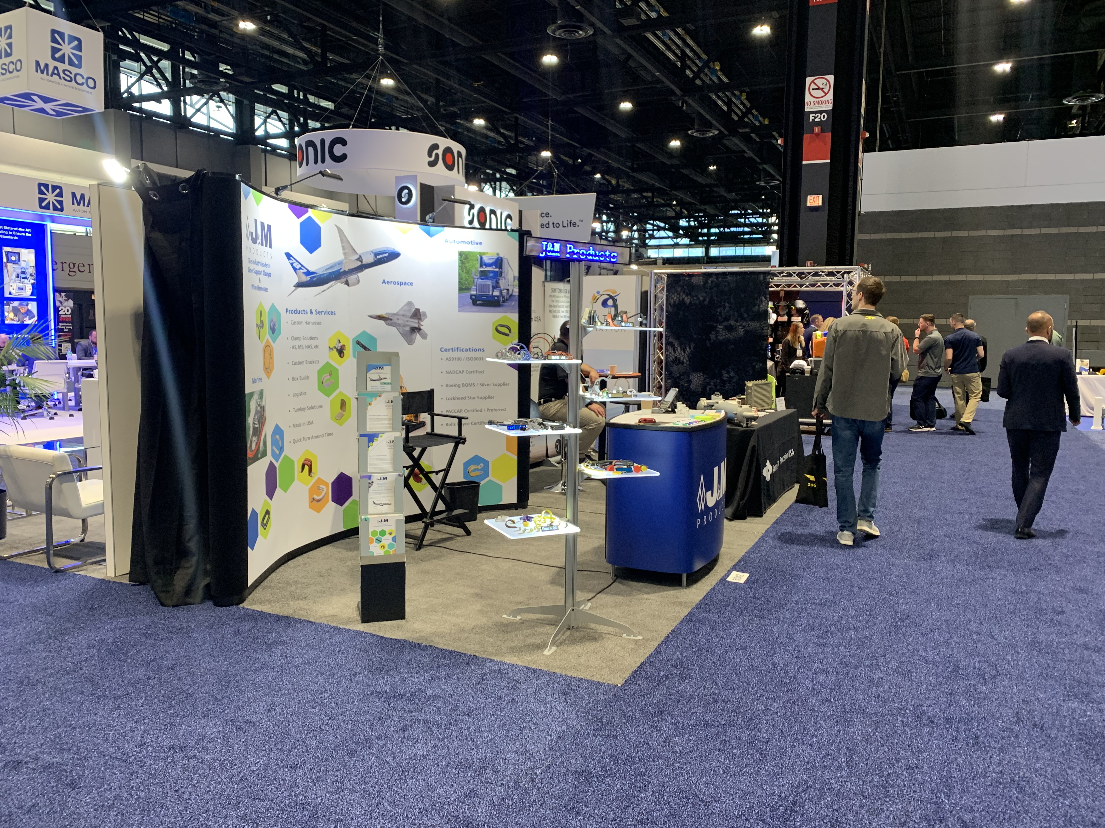
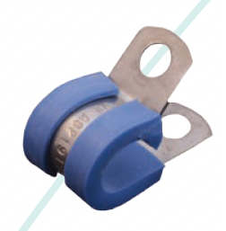
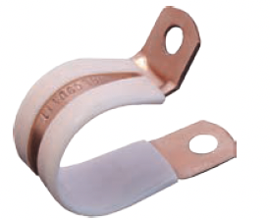
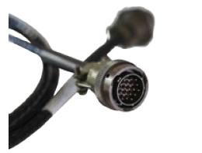
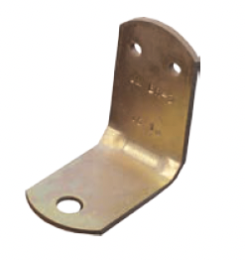
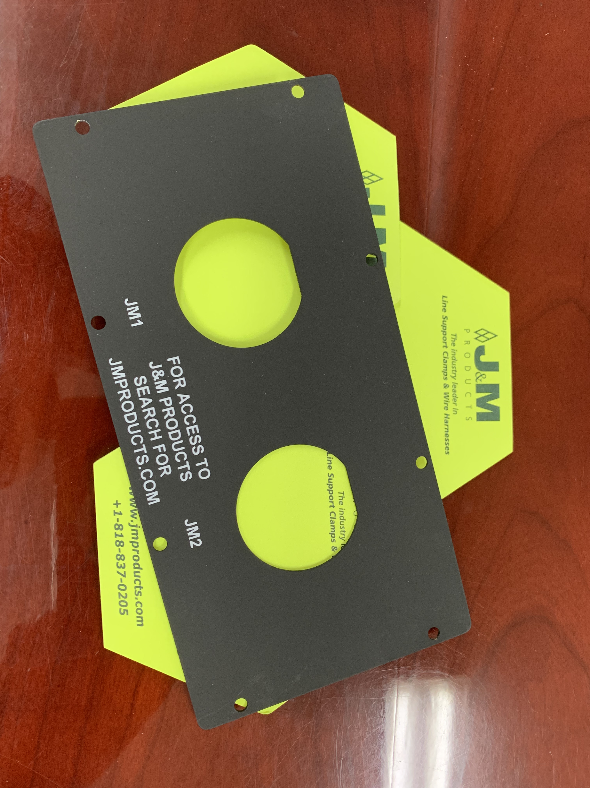

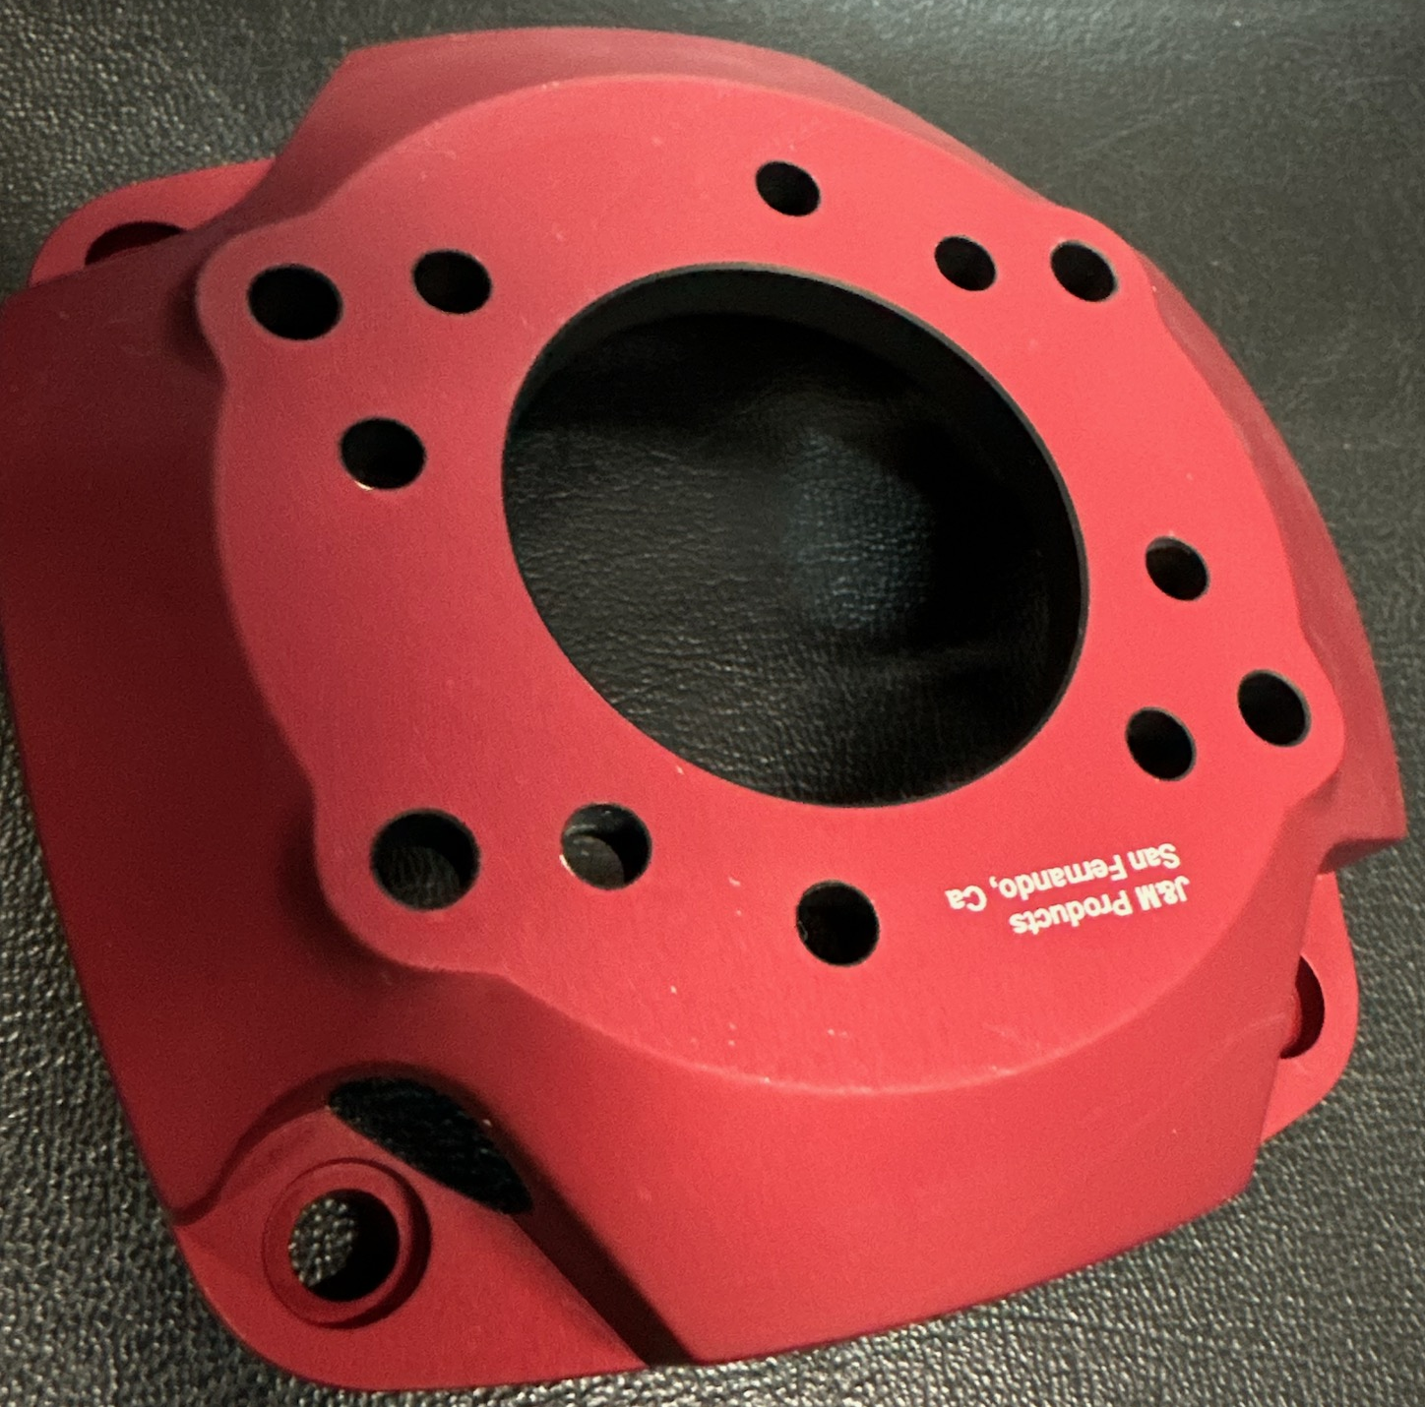
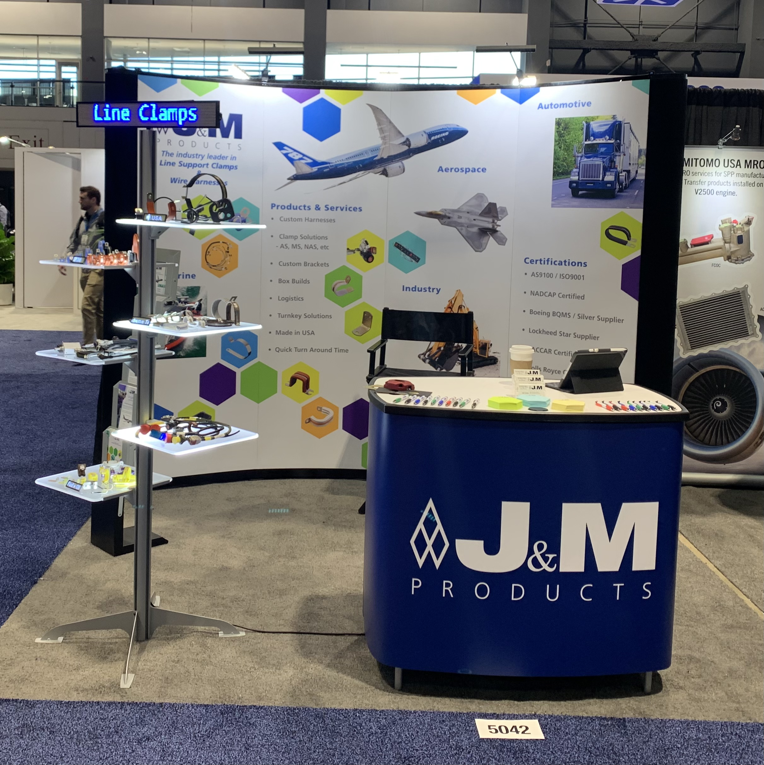
Left Panel = Clamp
(view looking from right)
Right Panel = EWIS
(view looking from left)
J & M
J & M
Brochures
This is a table 1000mmx500mm with clear top. This will show an array of clamps with some smaller machined parts
This is a table 1000mmx500mm, on top is the chassis and wire display that the subsequent slides mention
Brochures

Slide 2
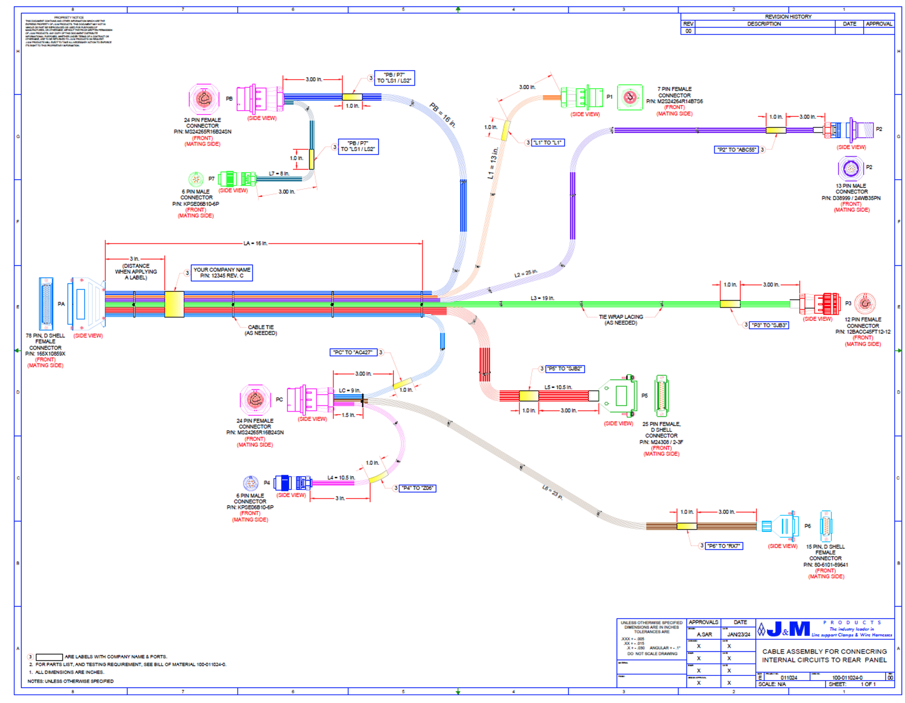
Right Panel = EWIS
Photo will be taken with wire harness constructed on top of paper drawing (this is fairly normal practice)
Image of computer representation of wiring to show technology level at J&M…not sure if I’m going left image or right image…and of course we will retake these photos

Slide 3
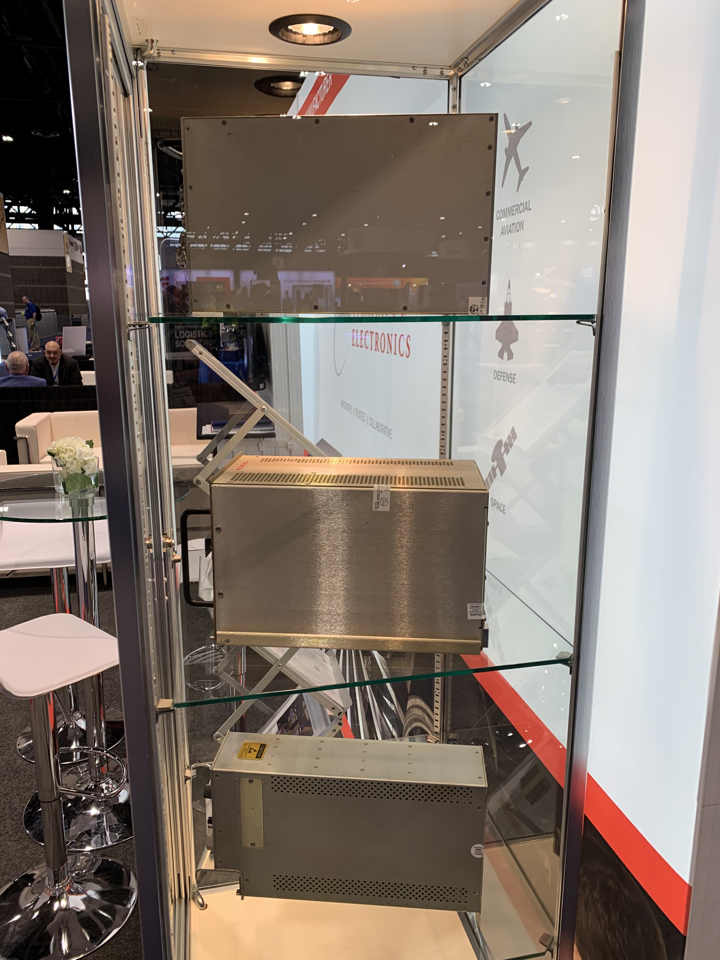
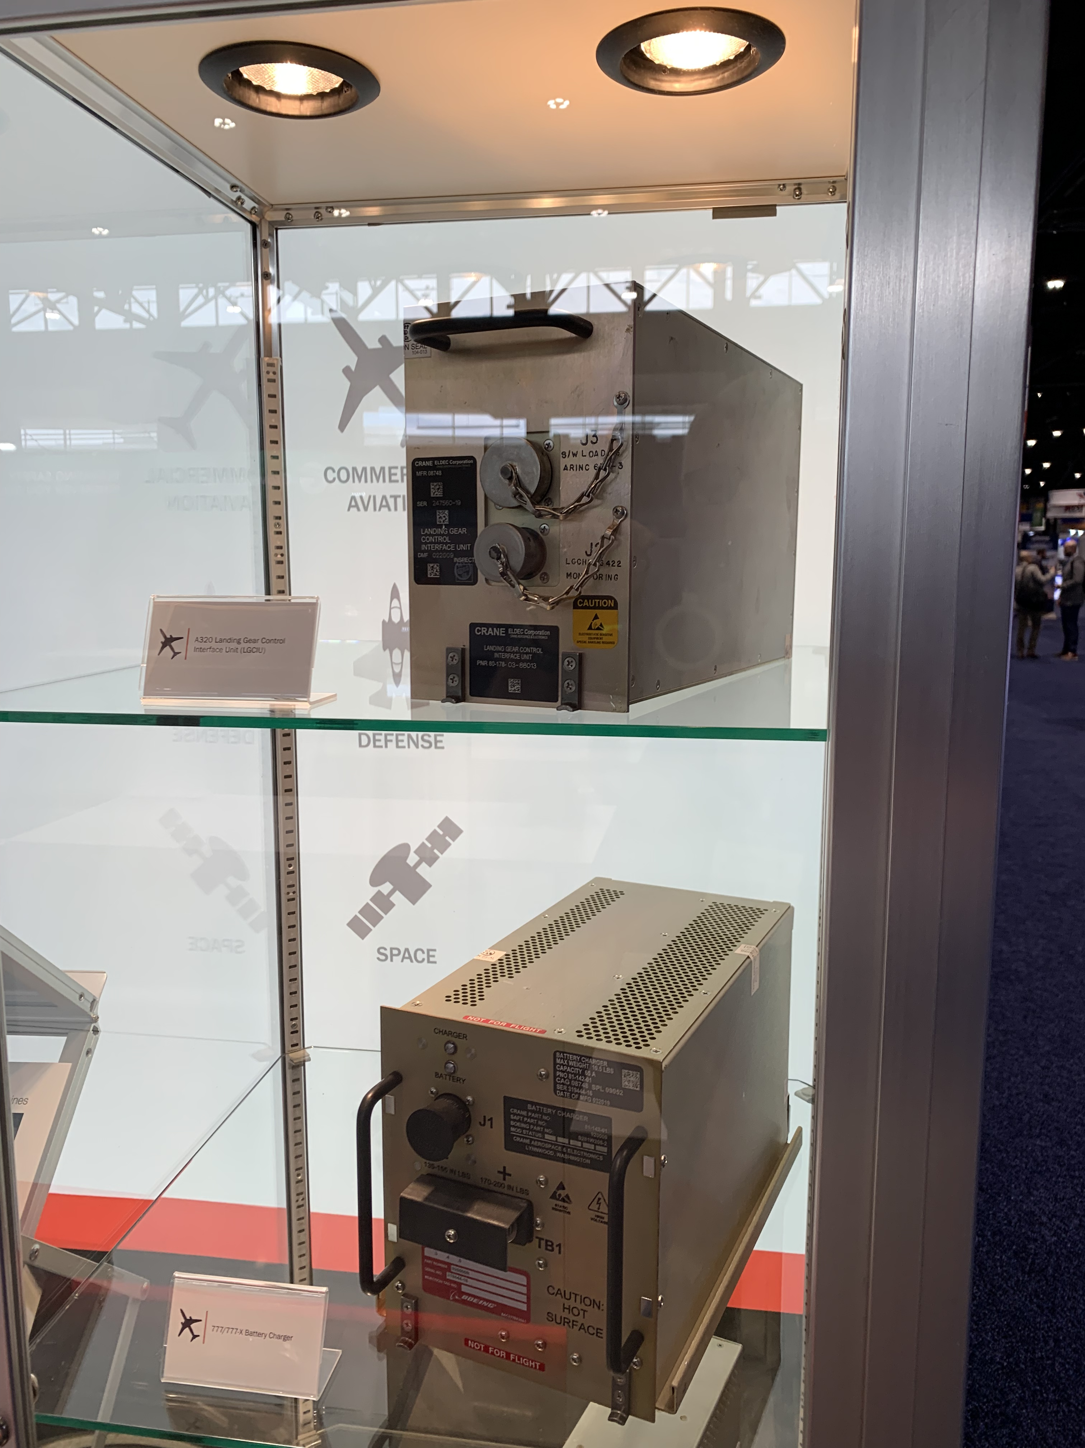
This is an example of a typical “chassis” used for aircraft electronics. It is part of EWIS. We are making a custom chassis for our show that will have an LED light show showing through this “J&M” panel.
There are many chassis utilized in aerospace and ground vehicles, I would expect to attract attention because we can “do it all”…

Slide 4
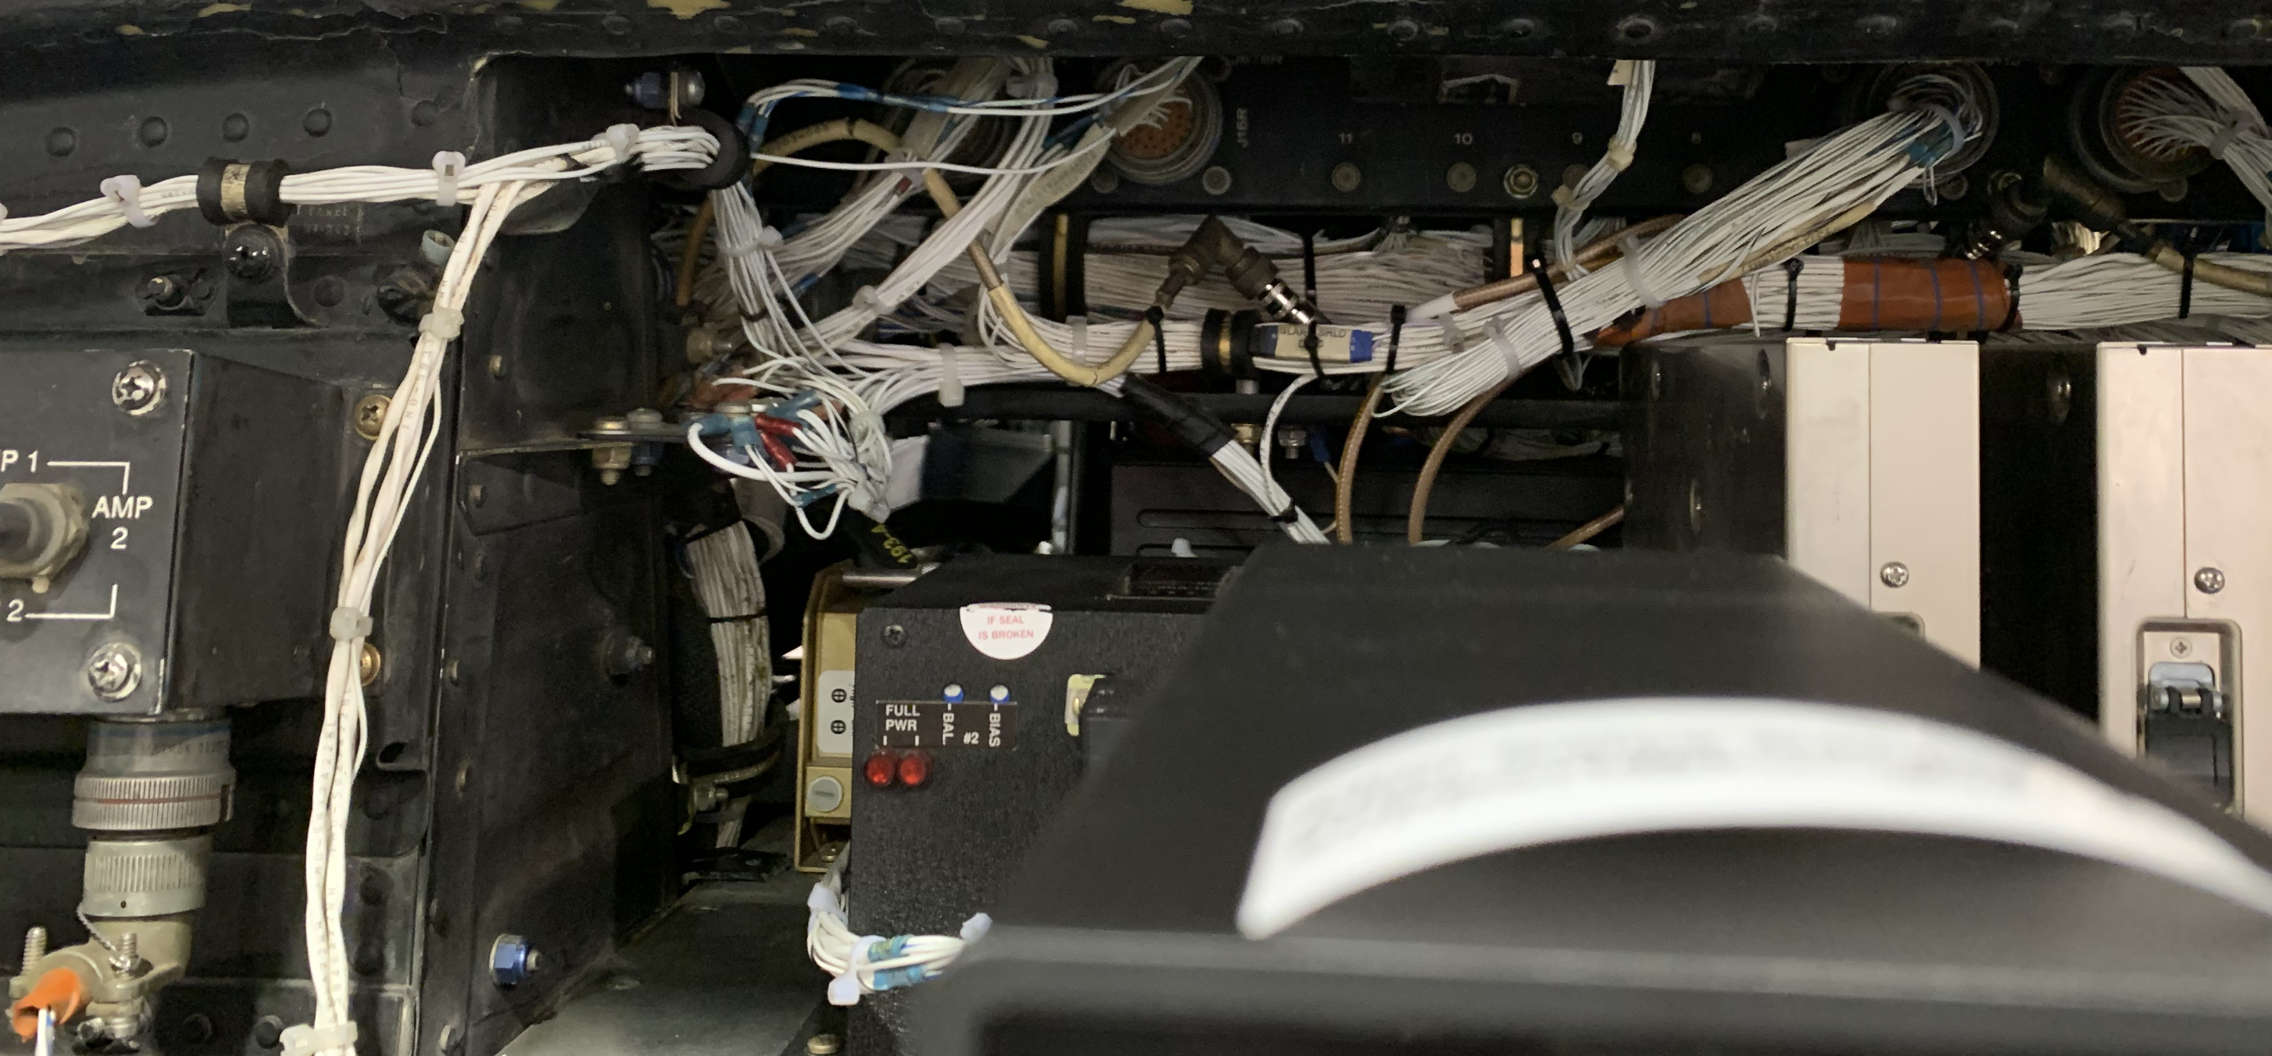
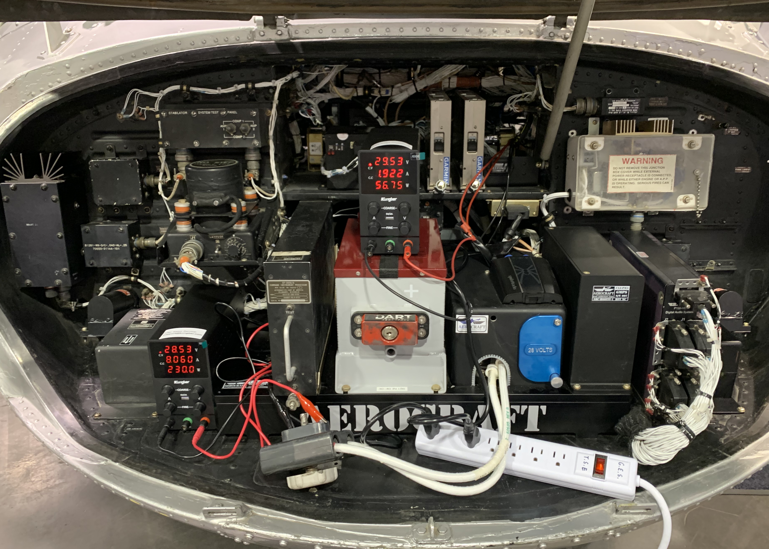
This is an example of EWIS on a helicopter at a tradeshow. You can see the white cabling and clamps on those cables, along with multiple different styles of chassis. We will be able to manufacture most of these chassis types.
This is an example of a chassis “tray” that I bought on ebay. It came out of a 747. You can see the wiring and clamps still there. We will replicate this connection for our show using a large ARINC600 connector, our own wire bundle connection, many connector types at the end of the wiring and J&M clamps along the length of it.
We think we will make a “tree” for the connectors to be shown, which is the tall thing on the “Right Panel” image.

Slide 5
These are examples of some machined parts. The large metal box below will be mounted on the wall of the booth as if it is a TV, and then the LED J&M display will also be installed on this box.
It is meant to show that we can make many types of chassis, from multiple panel boxes to one huge box like this (made from one piece of metal)

Slide 6
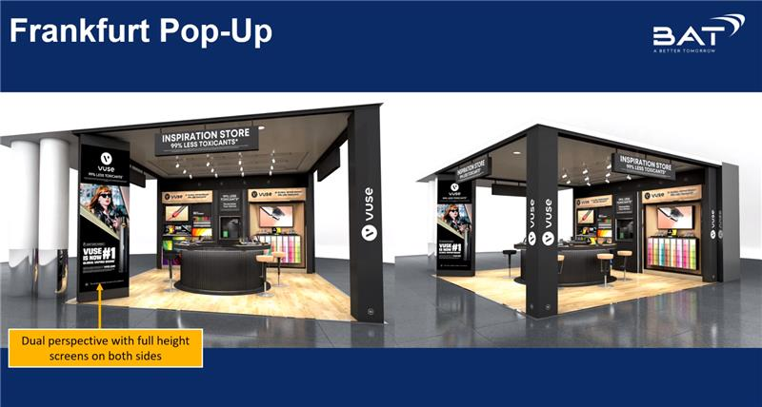

Slide 7
I regularly get compliments on this display from random people at the shows. The illuminated shelves are custom modified (to be illuminated) by me and the large LED readout is meant to attract attention in our direction. There are small name badges on each shelf explaining very roughly what the shelf is about.

